Slide 1


Andover new theatre project
Andy Thompson and Aaron Porter

Slide 2
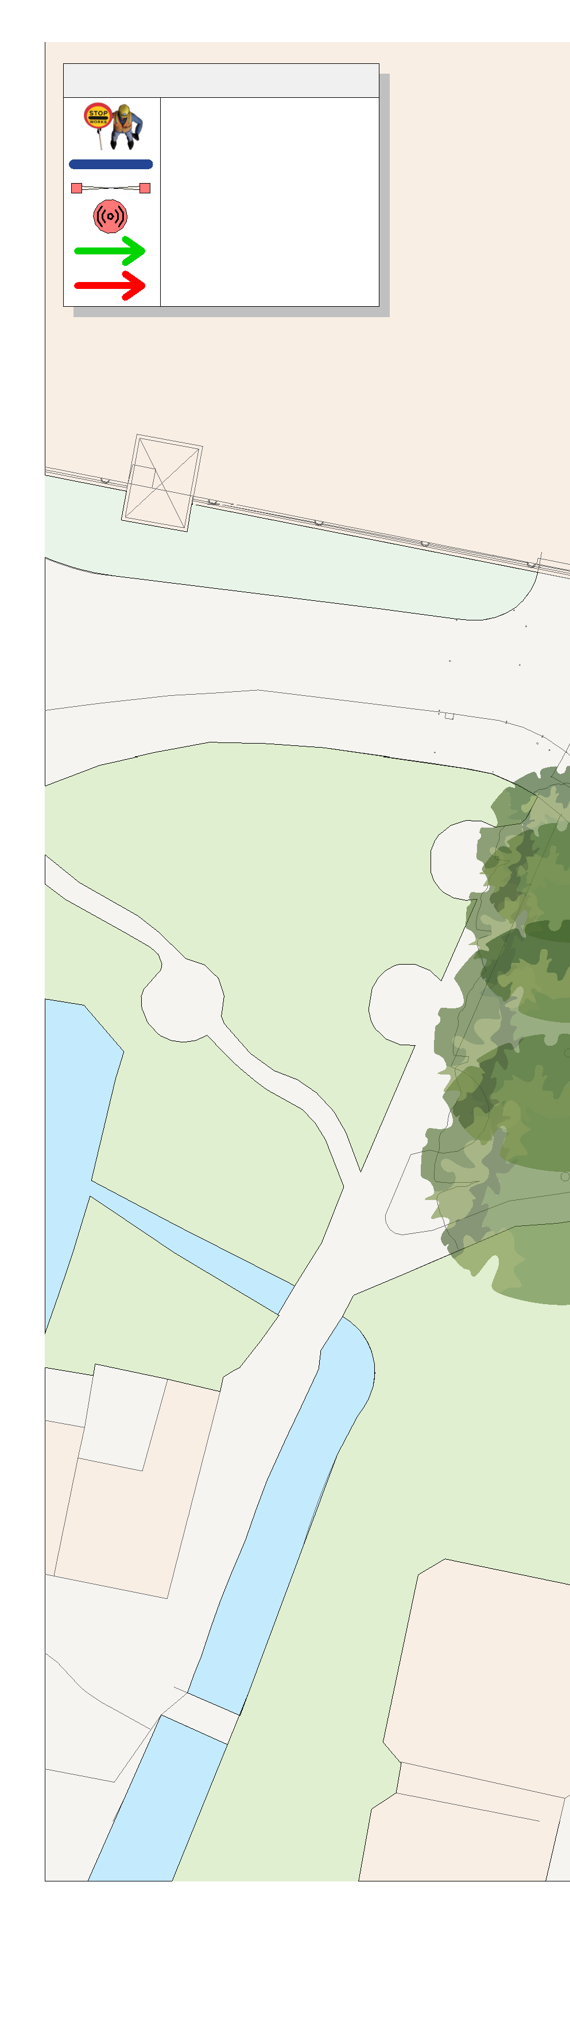
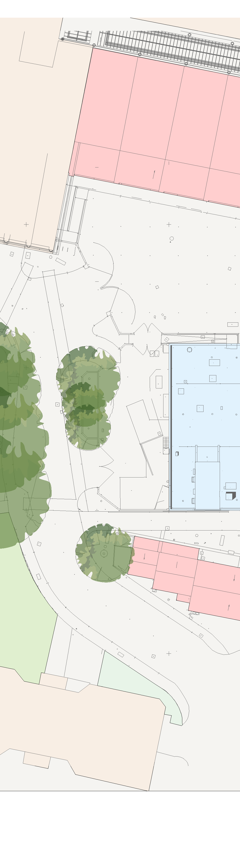
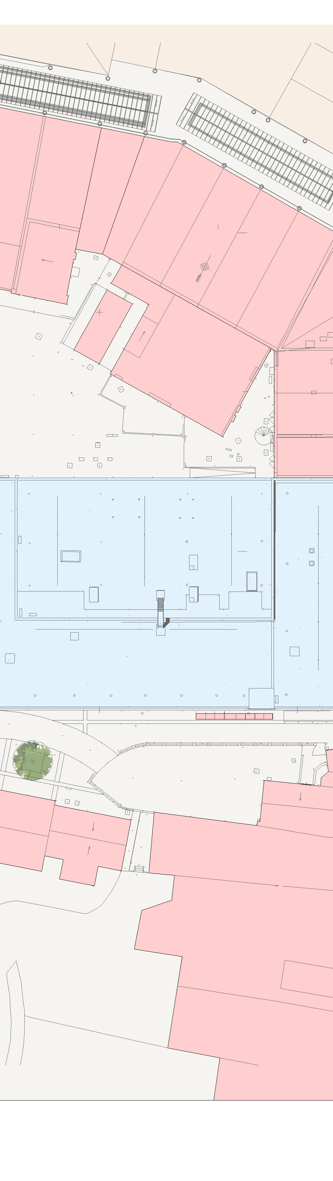
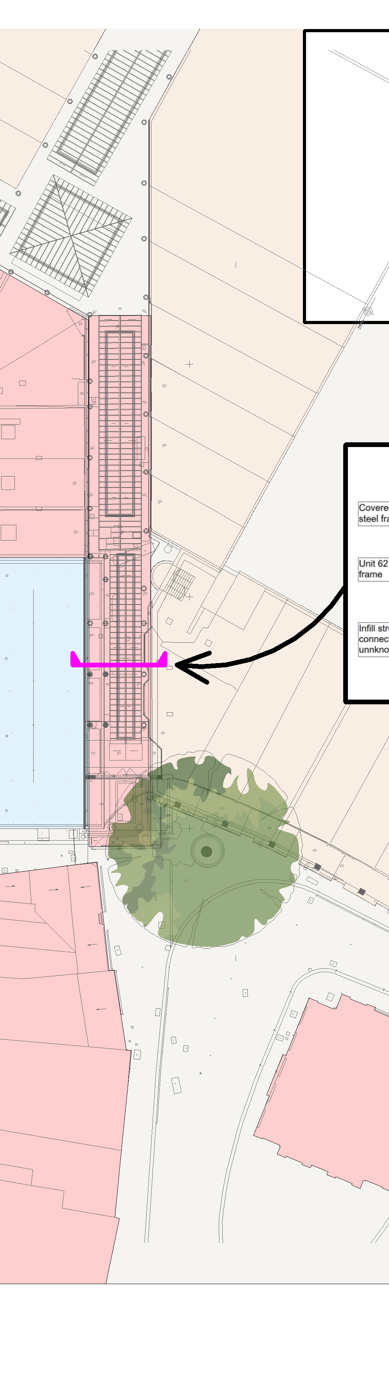
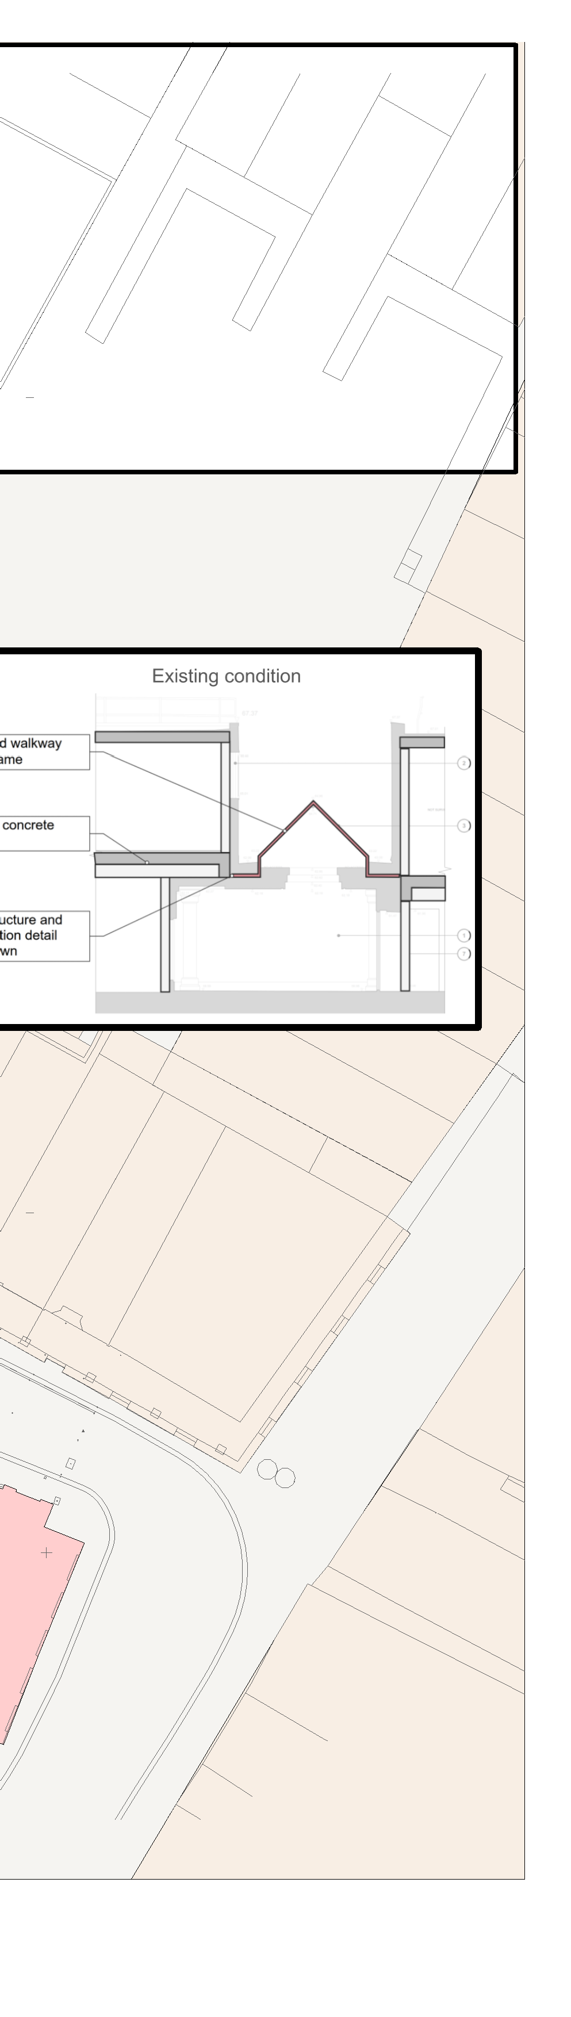





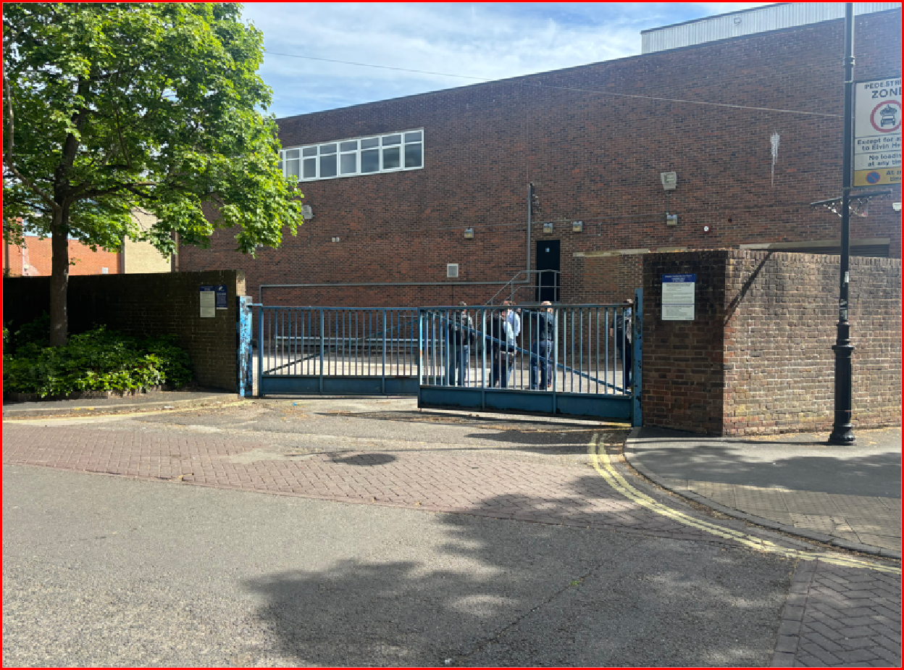


1
2
3
4
5
6
7
8
9
10 11
12
Copyright © 2021
KEY LEGEND
67 to 69
31 TO 37
1. Canopy above Chantry Centre entrance partially removed.
3. Access to be maintained to upper level of service yard.
DENOTES TRAFFIC MARSHAL
68
Chantry Centre roof Glazing to be removed.
Bike park units to be removed.
Sub station.
All barriers, stairs and platforms to be removed from rear of Unit 62.
Ramp to be retained.
Chantry Centre columns to be removed.
Waterloo Court signage to be removed and stored.
Double gates and adjacent walls to be removed.
Rear wall of service yard and adjacent planter to be retained.
All trees to be protected. Refer to preliminary ecology report and tree method statement for required protection measures.
A
ERITH HOARDING LINE
SITE GATE
DENOTES NOISE, DUST & VIBRATION MONITORING
ACCESS
66
65
A
64
63b
63
EGRESS
44
THE CHANTRY CENTRE
39
15. Double gates to service yard north of Unit 62 to be retained.
Chantry Centre entrance doors to be retained.
Smoke ventilation vents and associated duct roots in roof to be retained.
Chantry Centre signage to be retained.
Curved facade structure to be retained and supported by new structure -refer to SE information for detail.21. Post and telephone boxes
B
B
CHANTRY CENTRE CAR PARK
retained.
7
THE CHANTRY CENTRE
C
SERVICE YARD
SHOPPING MALL
C
WATERLOO COURT
SUB STATION
WATERLOO CHANTRY
15
LAMP POST
12
3
D
TOWN MILLS
9
D
RIVER SIDE PARK
14
10
13
8
E
12
37
57
E
6
21
17
40 to 43
PEDESTRIAN
BICYCLE PARK
47
TRAFFIC
LAMP POST
11
1
HIGH STREET
CAR PARK
35
WATERLOO CHANTRY
F
BOLLARD'S
WAVERLEY BUILDINGS
CAR PARK
14
51 to 53
F
WATERLOO COURT
SANTANDER
WATERLOO CHANTRY
20
POST OFFICE
G
HIGH STREET
GUILDHALL
G
WATERLOO CHANTRY
SIMPLY HEALTH
29
H
Erith Contractors Queen Street Erith
Kent DA8 1RP
Tel: +44 (0)370 950 8800
Fax: +44 (0)370 950 8808
PROJECT:
CHANTRY CENTRE UNIT 62
3 4
DRAWING:
SITE CONSTRAINTS
NOTES
As indicated @A1
DRAWN:
EP
CHECKED:
AH
APPROVED:
GS
H
TENDER
Scale:
1. THIS DRAWING IS TO BE READ IN CONJUNCTION
N
WITH ALL RELEVANT ARCHITECTS & ENGINEERS DRAWINGS AND SPECIFICATIONS
2. DO NOT SCALE FROM THIS DRAWING
PROJECT NO. SHEET NO.
T25-0257 - PL001
REV:
P0
1
2
5
6
7
8
9
10
11
12

Slide 3

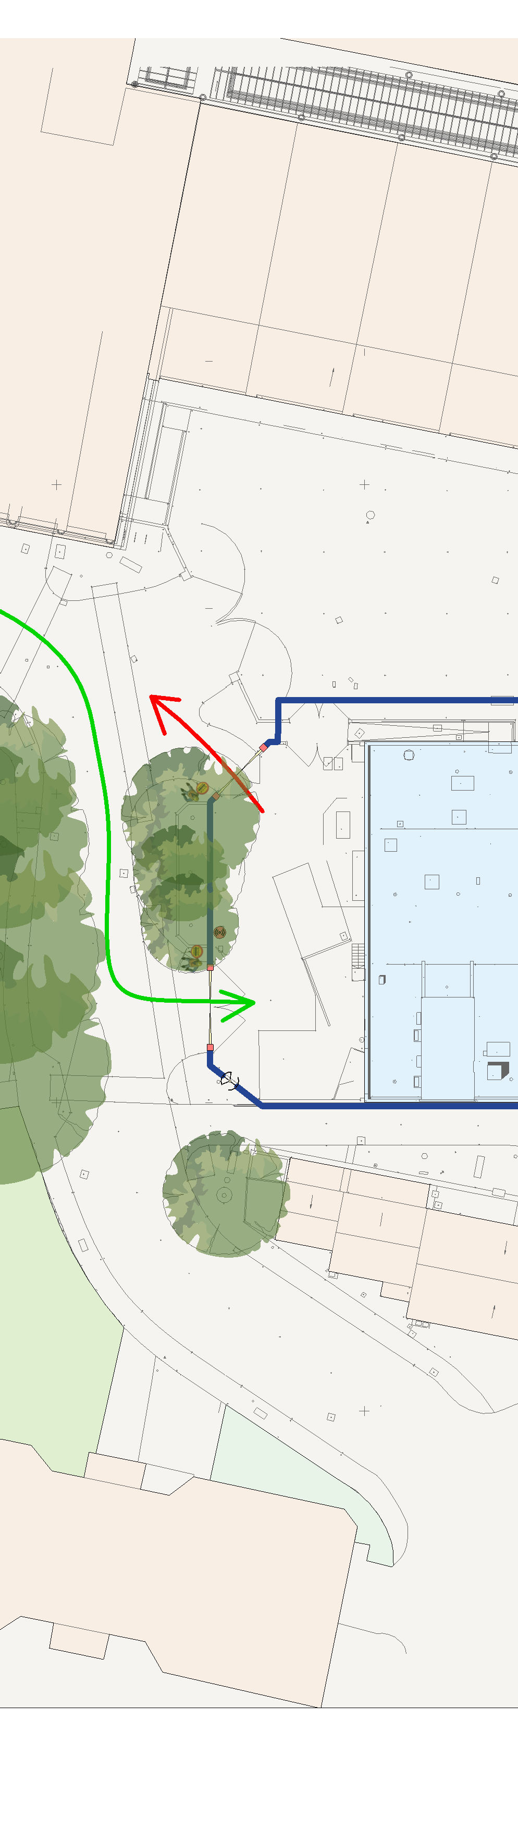
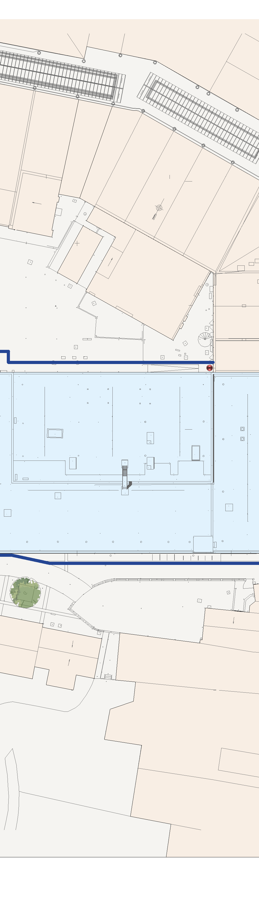
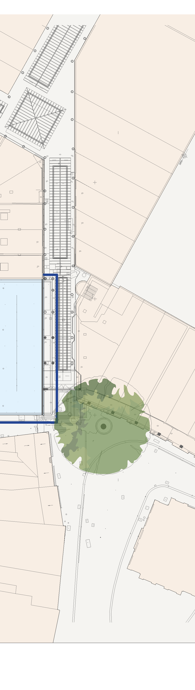
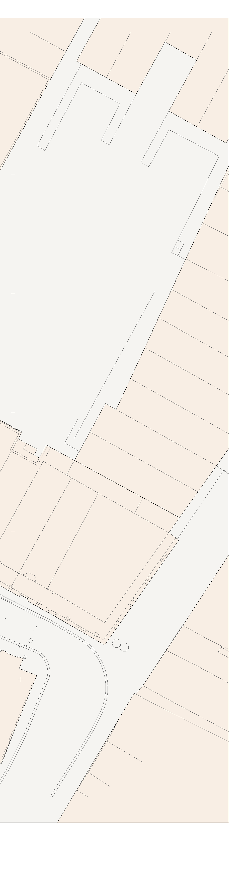


1
2
3
4
5
67 to 69
6
7
8
9
10
11
12
Copyright © 2021
KEY LEGEND
31 TO 37
A
DENOTES TRAFFIC MARSHAL
68
66
ERITH HOARDING LINE
SITE GATE
DENOTES NOISE, DUST & VIBRATION MONITORING
ACCESS
65
64
A
63b
63
EGRESS
44
THE CHANTRY CENTRE
39
B
B
CHANTRY CENTRE CAR PARK
THE CHANTRY CENTRE
C
SERVICE YARD
SHOPPING MALL
C
WATERLOO COURT
SUB STATION
WATERLOO CHANTRY
HOARDING
D
TOWN MILLS
D
RIVER SIDE PARK
E
37
57
E
40 to 43
47
35
HIGH STREET
F
CAR PARK
51 to 53
WATERLOO CHANTRY
F
WAVERLEY BUILDINGS
WATERLOO COURT
SANTANDER
WATERLOO CHANTRY
20
POST OFFICE
G
HIGH STREET
GUILDHALL
G
WATERLOO CHANTRY
SIMPLY HEALTH
29
H
Erith Contractors Queen Street Erith
Kent DA8 1RP
Tel: +44 (0)370 950 8800
Fax: +44 (0)370 950 8808
PROJECT:
CHANTRY CENTRE UNIT 62
3 4
DRAWING:
HOARDING PLAN
NOTES
As indicated @A1
DRAWN:
EP
CHECKED:
AH
APPROVED:
GS
H
TENDER
Scale:
1. THIS DRAWING IS TO BE READ IN CONJUNCTION
N
WITH ALL RELEVANT ARCHITECTS & ENGINEERS DRAWINGS AND SPECIFICATIONS
2. DO NOT SCALE FROM THIS DRAWING
PROJECT NO. SHEET NO.
T25-0257 - PL002
REV:
P0
1
2
5
6
7
8
9
10
11
12

Slide 4
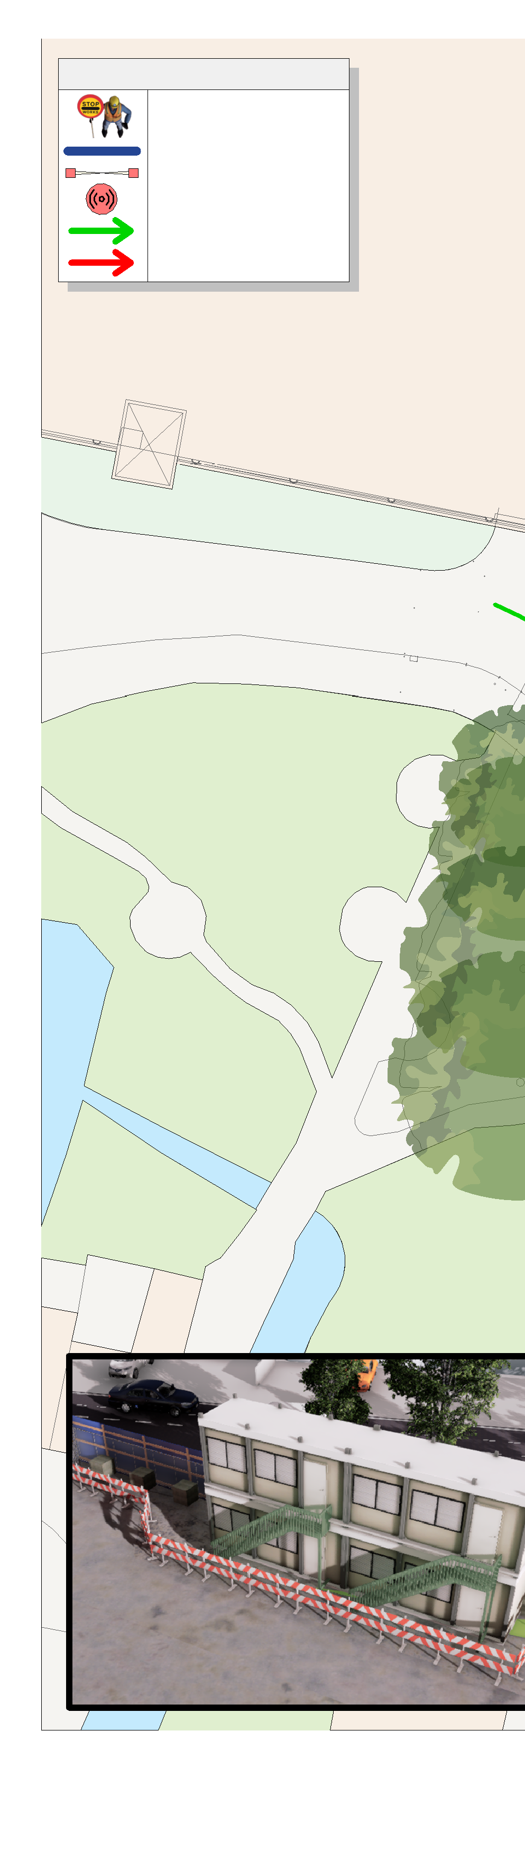
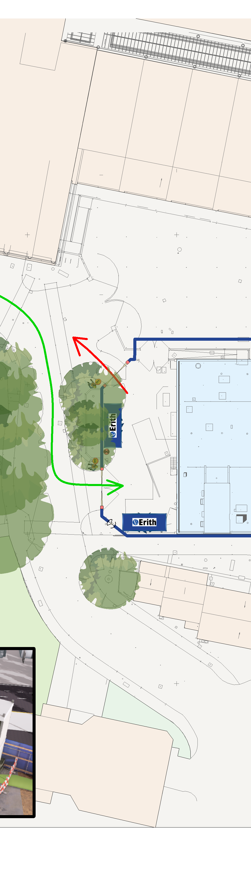
1
2
3
4
5
67 to 69
6
7
8
9
10
11
12
Copyright © 2021
KEY LEGEND
31 TO 37
A
DENOTES TRAFFIC MARSHAL
68
66
ERITH HOARDING LINE
SITE GATE
DENOTES NOISE, DUST & VIBRATION MONITORING
ACCESS
65
64
A
63b
63
EGRESS
44
THE CHANTRY CENTRE
39
B
B
CHANTRY CENTRE CAR PARK
THE CHANTRY CENTRE
C
SERVICE YARD
SHOPPING MALL
C
WATERLOO COURT
SUB STATION
WATERLOO CHANTRY
HOARDING
D
TOWN MILLS
D
RIVER SIDE PARK
E
37
57
E
40 to 43
SITE WELFARE
47
35
HIGH STREET
F
CAR PARK
51 to 53
WATERLOO CHANTRY
F
WAVERLEY BUILDINGS
WATERLOO COURT
SANTANDER
WATERLOO CHANTRY
G
POST OFFICE
HIGH STREET
GUILDHALL
G
WATERLOO CHANTRY
29
H
Erith Contractors Queen Street Erith
Kent DA8 1RP
Tel: +44 (0)370 950 8800
Fax: +44 (0)370 950 8808
PROJECT:
CHANTRY CENTRE UNIT 62
3 4
DRAWING:
SITE WELFARE
NOTES
As indicated @A1
DRAWN:
EP
CHECKED:
AH
APPROVED:
GS
H
TENDER
Scale:
1. THIS DRAWING IS TO BE READ IN CONJUNCTION
N
WITH ALL RELEVANT ARCHITECTS & ENGINEERS DRAWINGS AND SPECIFICATIONS
2. DO NOT SCALE FROM THIS DRAWING
PROJECT NO. SHEET NO.
T25-0257 - PL003
REV:
P0
1
2
5
6
7
8
9
10
11
12

Slide 5

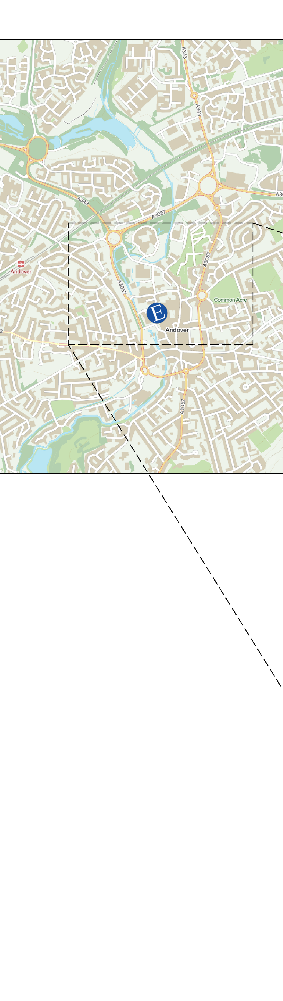
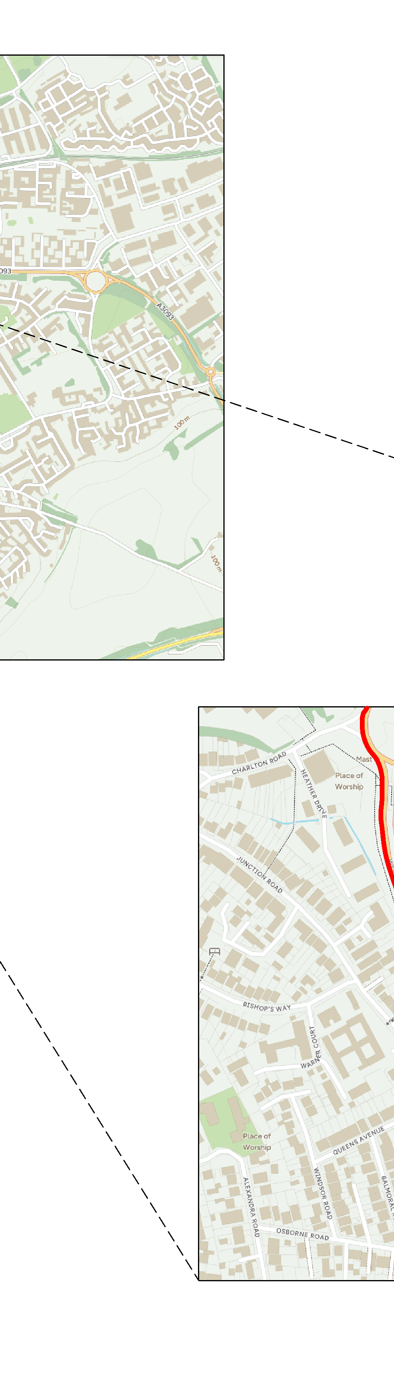
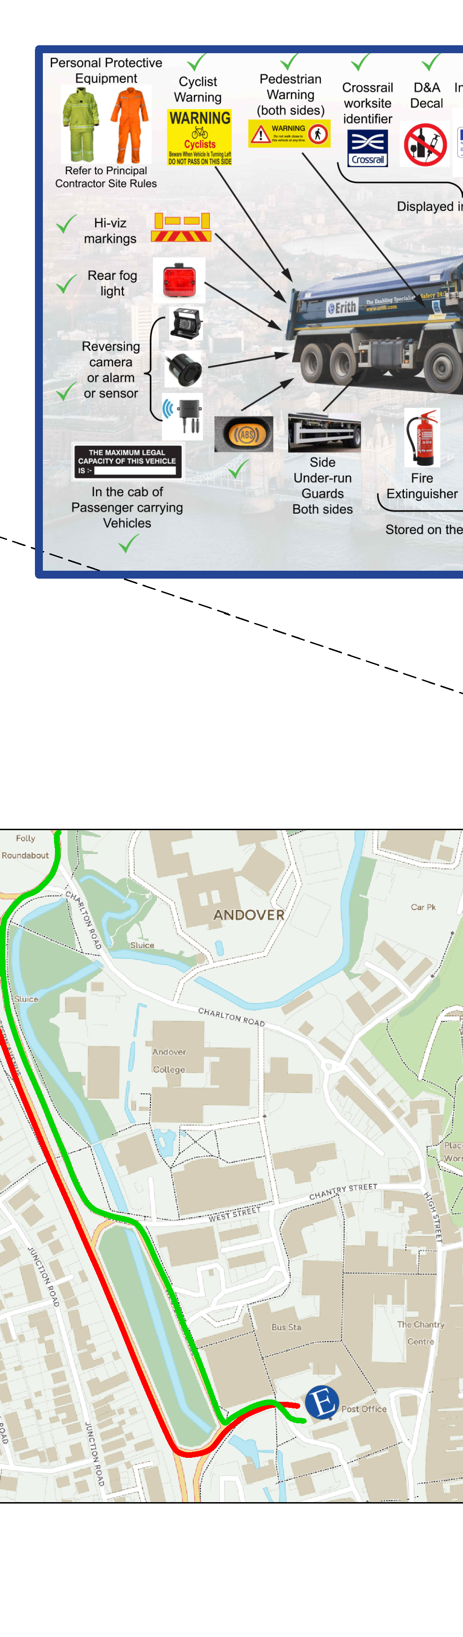
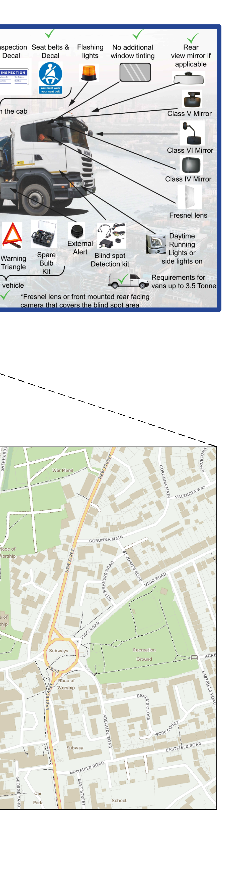
1
2
3
4
5
6
7
8
9
10
11
12
Copyright © 2021
A
A
B
B
C
C
D
D
KEY LEGEND
ACCESS EGRESS
E
SITE LOCATION
E
F
F
G
G
H
Erith Contractors Queen Street Erith
Kent DA8 1RP
Tel: +44 (0)370 950 8800
Fax: +44 (0)370 950 8808
PROJECT:
CHANTRY CENTRE UNIT 62
3 4
DRAWING:
TRAFFIC ROUTE
NOTES
DRAWN:
EP
CHECKED:
AH
APPROVED:
GS
H
TENDER
Scale: 1 : 100 @A1
1. THIS DRAWING IS TO BE READ IN CONJUNCTION
WITH ALL RELEVANT ARCHITECTS & ENGINEERS DRAWINGS AND SPECIFICATIONS
2. DO NOT SCALE FROM THIS DRAWING
PROJECT NO. SHEET NO.
T25-0257 - PL004
REV:
P0
1
2
5
6
7
8
9
10
11
12

Slide 6
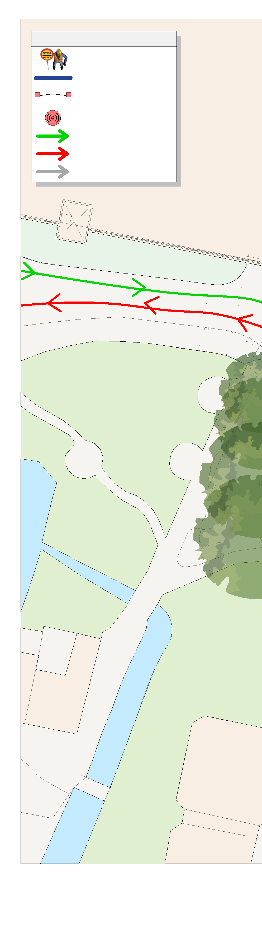
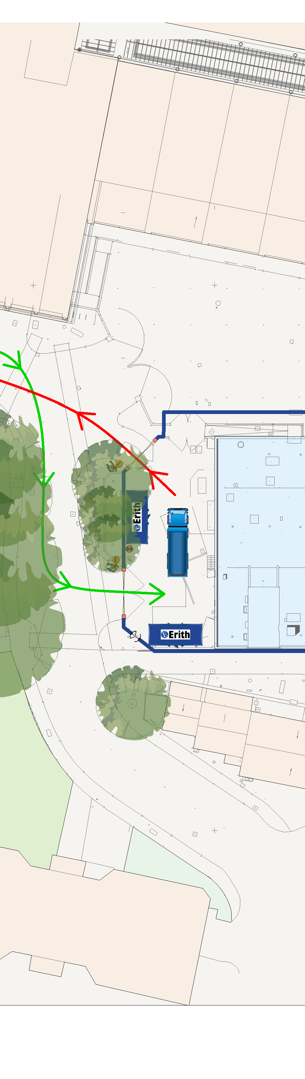
1
2
3
4
5
67 to 69
6
7
8
9
10
11
12
Copyright © 2021
KEY LEGEND
31 TO 37
A
DENOTES TRAFFIC MARSHAL
68
66
A
ERITH HOARDING LINE
65
64
SITE GATE
63b
63
DENOTES NOISE, DUST & VIBRATION MONITORING
44
ACCESS
THE CHANTRY CENTRE
39
EGRESS
B
REVERSE MANOEUVRE
B
CHANTRY CENTRE CAR PARK
THE CHANTRY CENTRE
C
SERVICE YARD
SHOPPING MALL
C
WATERLOO COURT
SUB STATION
WATERLOO CHANTRY
HOARDING
D
TOWN MILLS
D
RIVER SIDE PARK
E
37
57
E
40 to 43
SITE WELFARE
47
35
HIGH STREET
F
CAR PARK
51 to 53
WATERLOO CHANTRY
F
WAVERLEY BUILDINGS
WATERLOO COURT
SANTANDER
WATERLOO CHANTRY
20
POST OFFICE
G
HIGH STREET
GUILDHALL
G
WATERLOO CHANTRY
SIMPLY HEALTH
29
H
Erith Contractors Queen Street Erith
Kent DA8 1RP
Tel: +44 (0)370 950 8800
Fax: +44 (0)370 950 8808
PROJECT:
CHANTRY CENTRE UNIT 62
3 4
DRAWING:
VEHICLE ACCESS / EGRESS
6 7
NOTES
As indicated @A1
DRAWN:
EP
CHECKED:
AH
APPROVED:
GS
H
TENDER
Scale:
1. THIS DRAWING IS TO BE READ IN CONJUNCTION
N
WITH ALL RELEVANT ARCHITECTS & ENGINEERS DRAWINGS AND SPECIFICATIONS
2. DO NOT SCALE FROM THIS DRAWING
PROJECT NO. SHEET NO.
T25-0257 - PL005
REV:
P0
1
2
5
8
9
10
11
12

Slide 7
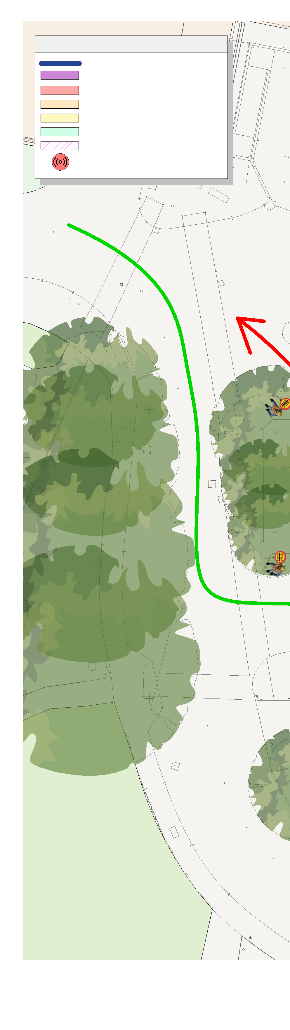
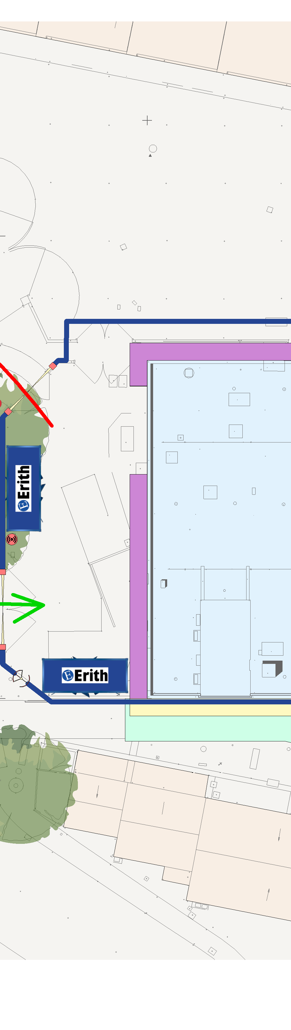
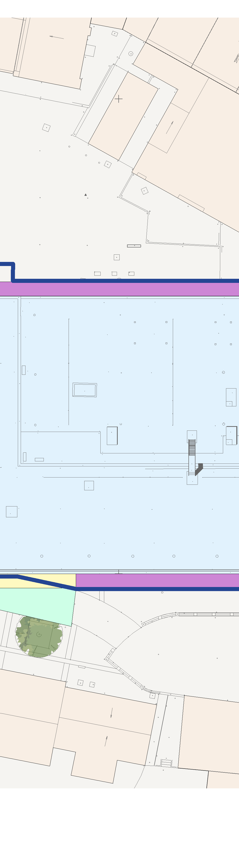
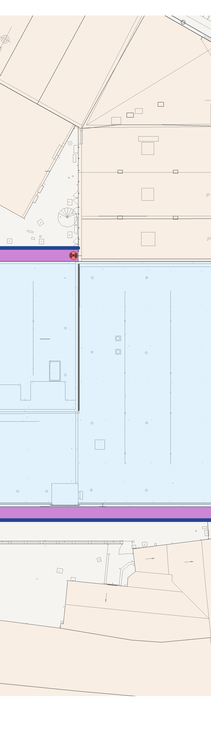
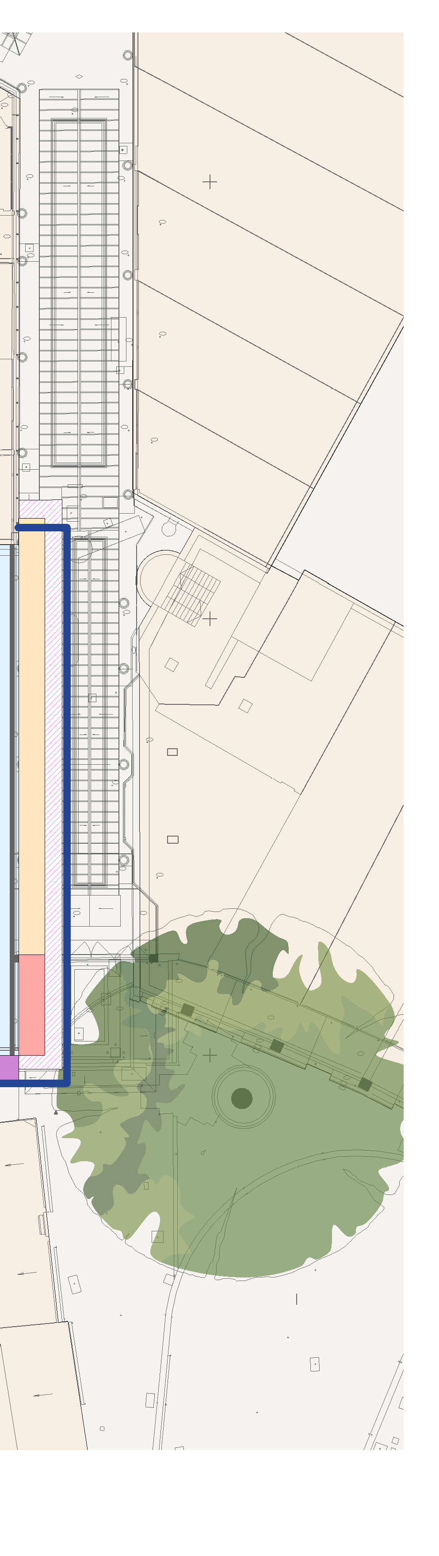

1
2
3
4
5
6
7
8
9
10
11
12
Copyright © 2021
KEY LEGEND
ERITH HOARDING LINE
SCAFFOLD BASED AT GROUND LEVEL
A
SCAFFOLD BASED AT FIRST FLOOR LEVEL
SCAFFOLD BASED AT ROOF LEVEL
SCAFFOLD BASED ON GANTRY
GANTRY/CRASH DECK BASED FOR CANOPY REMOVAL
SCAFFOLD FAN
DENOTES NOISE, DUST & VIBRATION MONITORING
A
SERVICE YARD
B
SUB STATION
B
HOARDING
C
C
D
D
E
37
E
40 to 43
F
SITE WELFARE
F
GANTRY TO ALLOW
CAR PARK
35
G
CARS TO THE
G
CARPARK
WAVERLEY BUILDINGS
WATERLOO COURT
WATERLOO CHANTRY
SANTANDER
H
Erith Contractors Queen Street Erith
Kent DA8 1RP
Tel: +44 (0)370 950 8800
Fax: +44 (0)370 950 8808
PROJECT:
CHANTRY CENTRE UNIT 62
3 4
DRAWING:
SCAFFOLD PLAN
NOTES
As indicated @A1
DRAWN:
EP
CHECKED:
AH
APPROVED:
GS
H
TENDER
Scale:
1. THIS DRAWING IS TO BE READ IN CONJUNCTION
N
WITH ALL RELEVANT ARCHITECTS & ENGINEERS DRAWINGS AND SPECIFICATIONS
2. DO NOT SCALE FROM THIS DRAWING
PROJECT NO. SHEET NO.
T25-0257 - PL006
REV:
P0
1
2
5
6
7
8
9
10
11
12

Slide 8
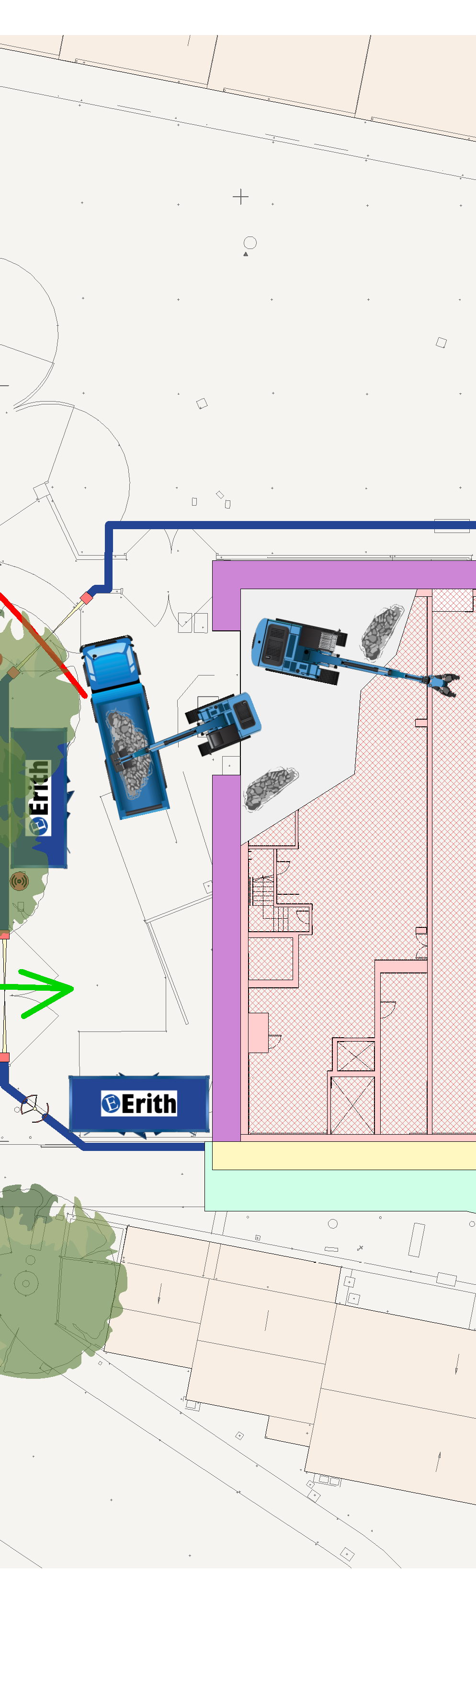
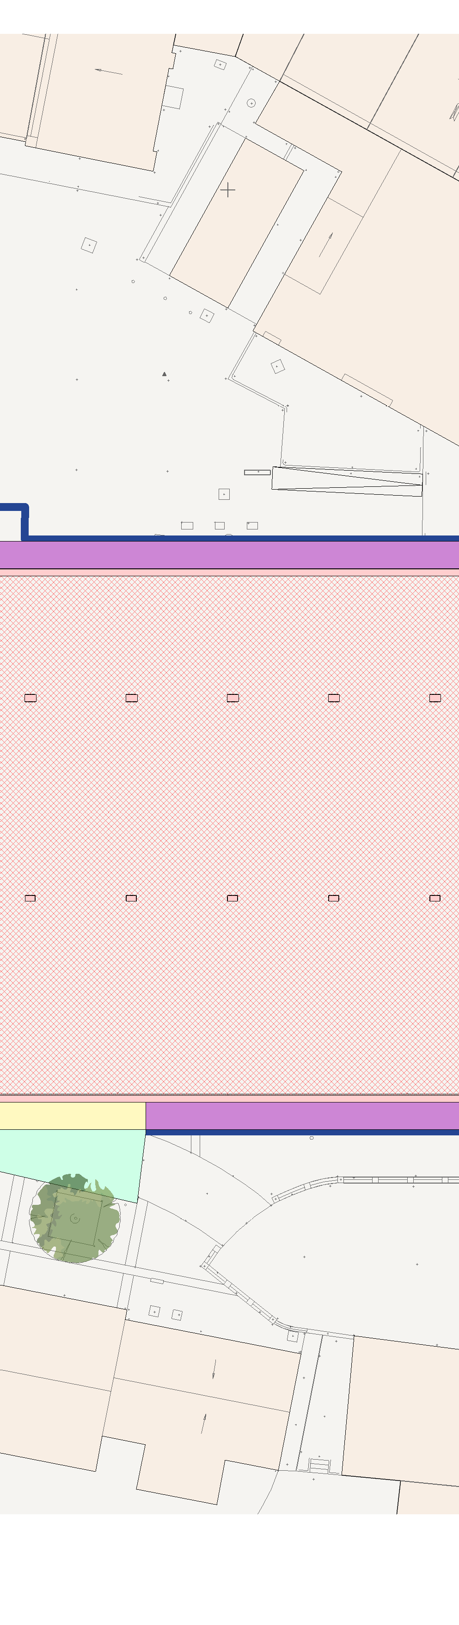
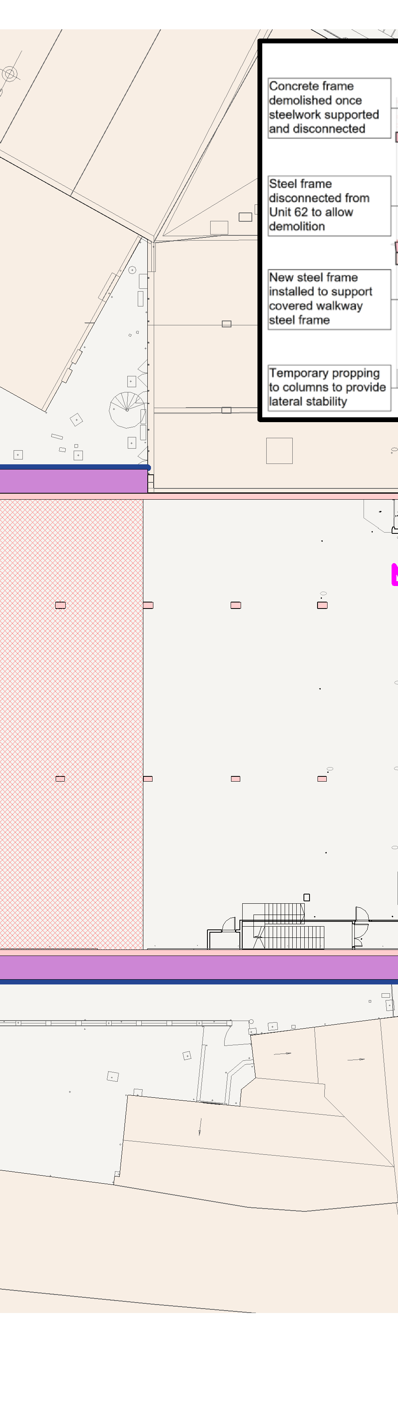
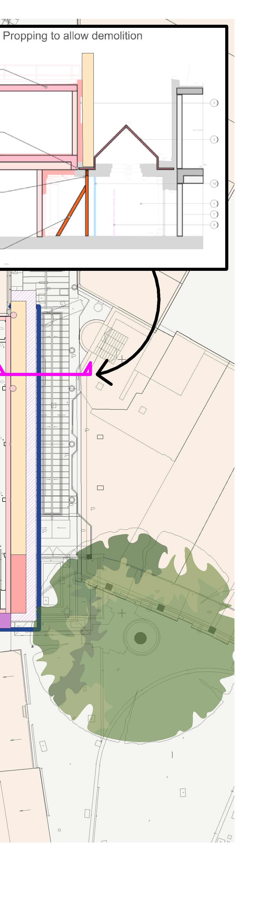
1
2
3
4
5
6
7
8
9
10
11
12
Copyright © 2021
KEY LEGEND
DENOTES TRAFFIC MARSHAL
A
ERITH HOARDING LINE
SITE GATE
DENOTES NOISE, DUST & VIBRATION MONITORING
ACCESS
A
EGRESS
SERVICE YARD
B
SUB STATION
B
HOARDING
TEMPORARY RAMP
C
C
D
D
5 NO GLAZING TO BE
REPLACED WITH PLASTIC
E
37
E
40 to 43
F
SITE WELFARE
F
CAR PARK
35
G
G
WAVERLEY BUILDINGS
WATERLOO COURT
WATERLOO CHANTRY
SANTANDER
H
Erith Contractors Queen Street Erith
Kent DA8 1RP
Tel: +44 (0)370 950 8800
Fax: +44 (0)370 950 8808
PROJECT:
CHANTRY CENTRE UNIT 62
3 4
DRAWING:
PHASE 01a DEMOLITION WORK
6 7
NOTES
As indicated @A1
DRAWN:
EP
CHECKED:
AH
APPROVED:
GS
H
TENDER
Scale:
1. THIS DRAWING IS TO BE READ IN CONJUNCTION
N
WITH ALL RELEVANT ARCHITECTS & ENGINEERS DRAWINGS AND SPECIFICATIONS
2. DO NOT SCALE FROM THIS DRAWING
PROJECT NO. SHEET NO.
T25-0257 - PL007
REV:
P0
1
2
5
8
9
10
11
12

Slide 9
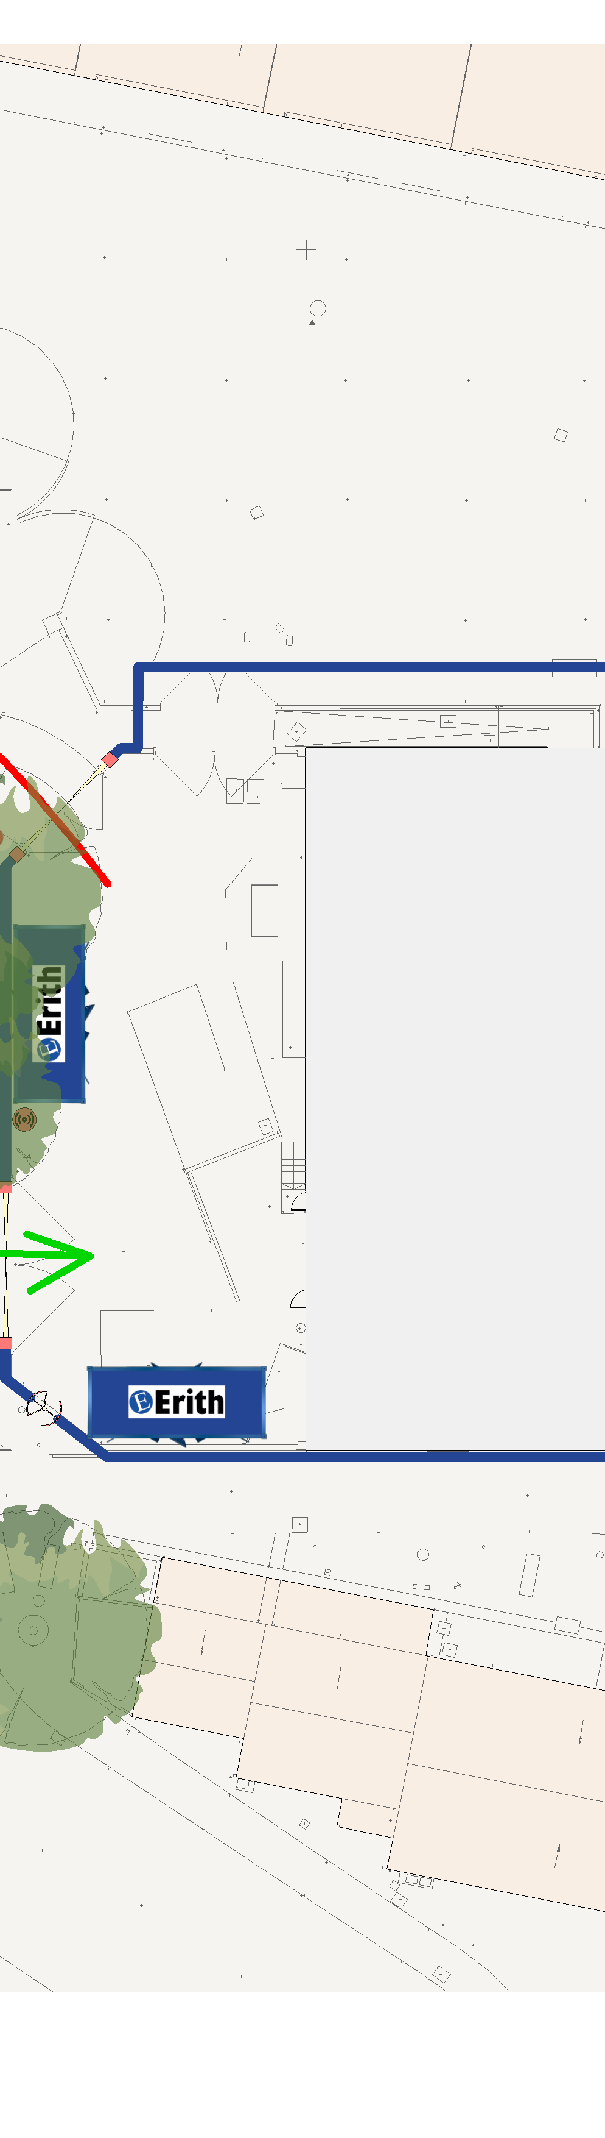
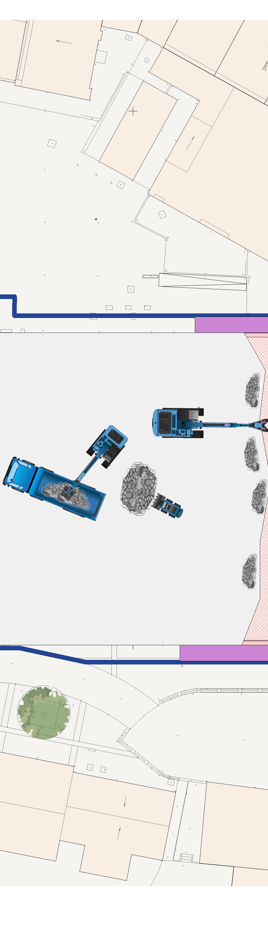
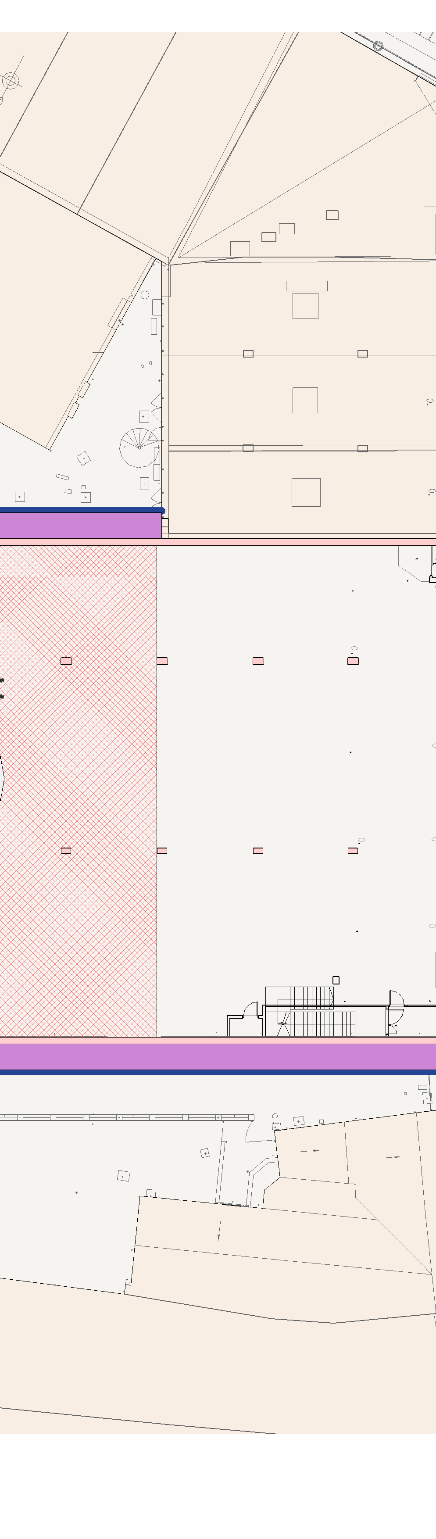
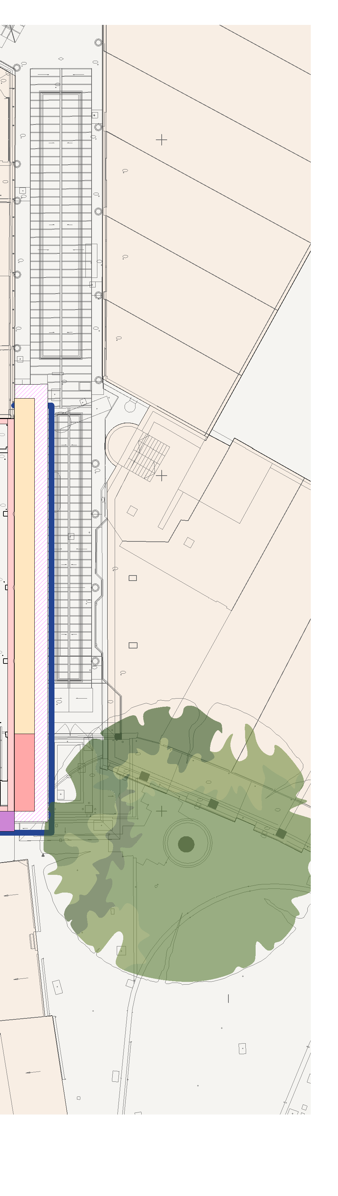
1
2
3
4
5
6
7
8
9
10
11
12
Copyright © 2021
KEY LEGEND
DENOTES TRAFFIC MARSHAL
A
ERITH HOARDING LINE
SITE GATE
DENOTES NOISE, DUST & VIBRATION MONITORING
ACCESS
A
EGRESS
SERVICE YARD
B
SUB STATION
B
HOARDING
TEMPORARY RAMP
C
C
D
D
E
37
E
40 to 43
F
SITE WELFARE
F
CAR PARK
35
G
G
WAVERLEY BUILDINGS
WATERLOO COURT
WATERLOO CHANTRY
SANTANDER
H
Erith Contractors Queen Street Erith
Kent DA8 1RP
Tel: +44 (0)370 950 8800
Fax: +44 (0)370 950 8808
PROJECT:
CHANTRY CENTRE UNIT 62
3 4
DRAWING:
PHASE 01b DEMOLITION WORK
6 7
NOTES
As indicated @A1
DRAWN:
EP
CHECKED:
AH
APPROVED:
GS
H
TENDER
Scale:
1. THIS DRAWING IS TO BE READ IN CONJUNCTION
N
WITH ALL RELEVANT ARCHITECTS & ENGINEERS DRAWINGS AND SPECIFICATIONS
2. DO NOT SCALE FROM THIS DRAWING
PROJECT NO. SHEET NO.
T25-0257 - PL008
REV:
P0
1
2
5
8
9
10
11
12

Slide 10
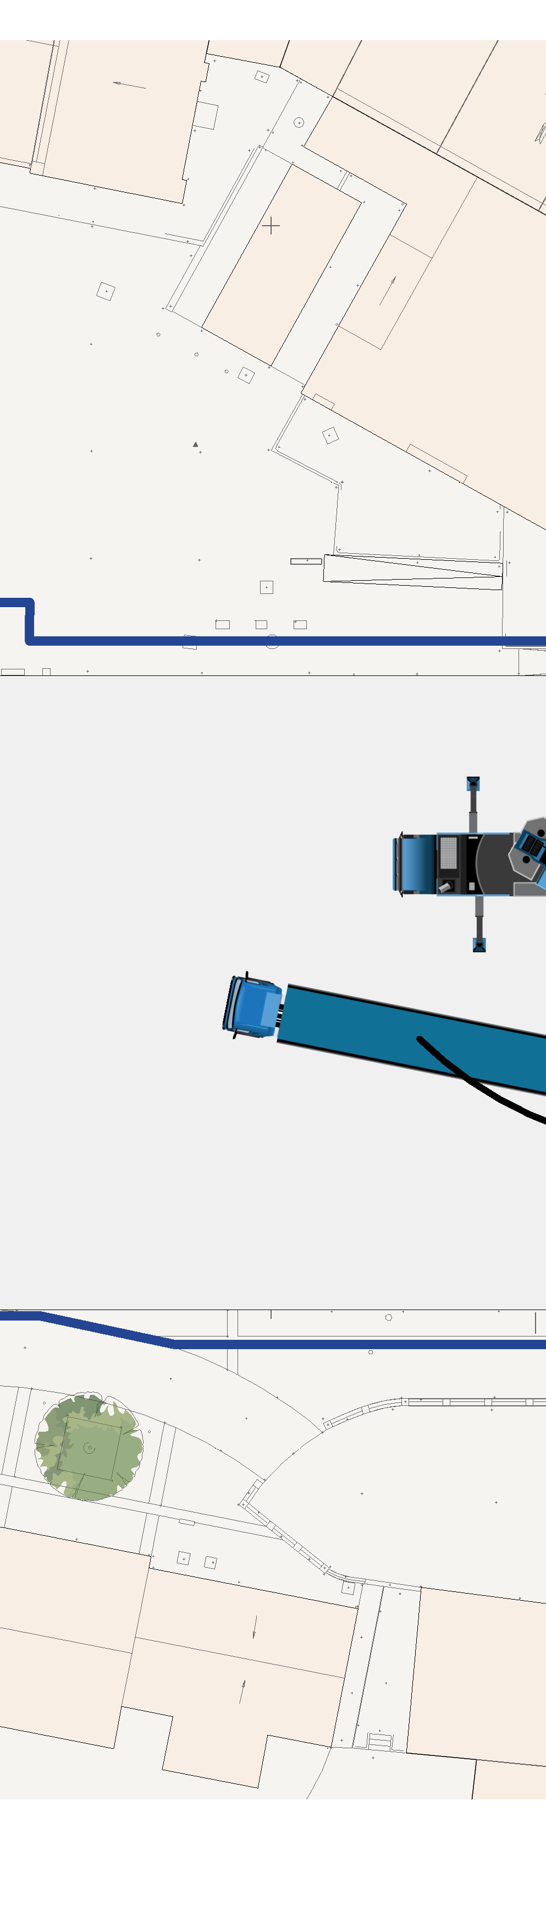
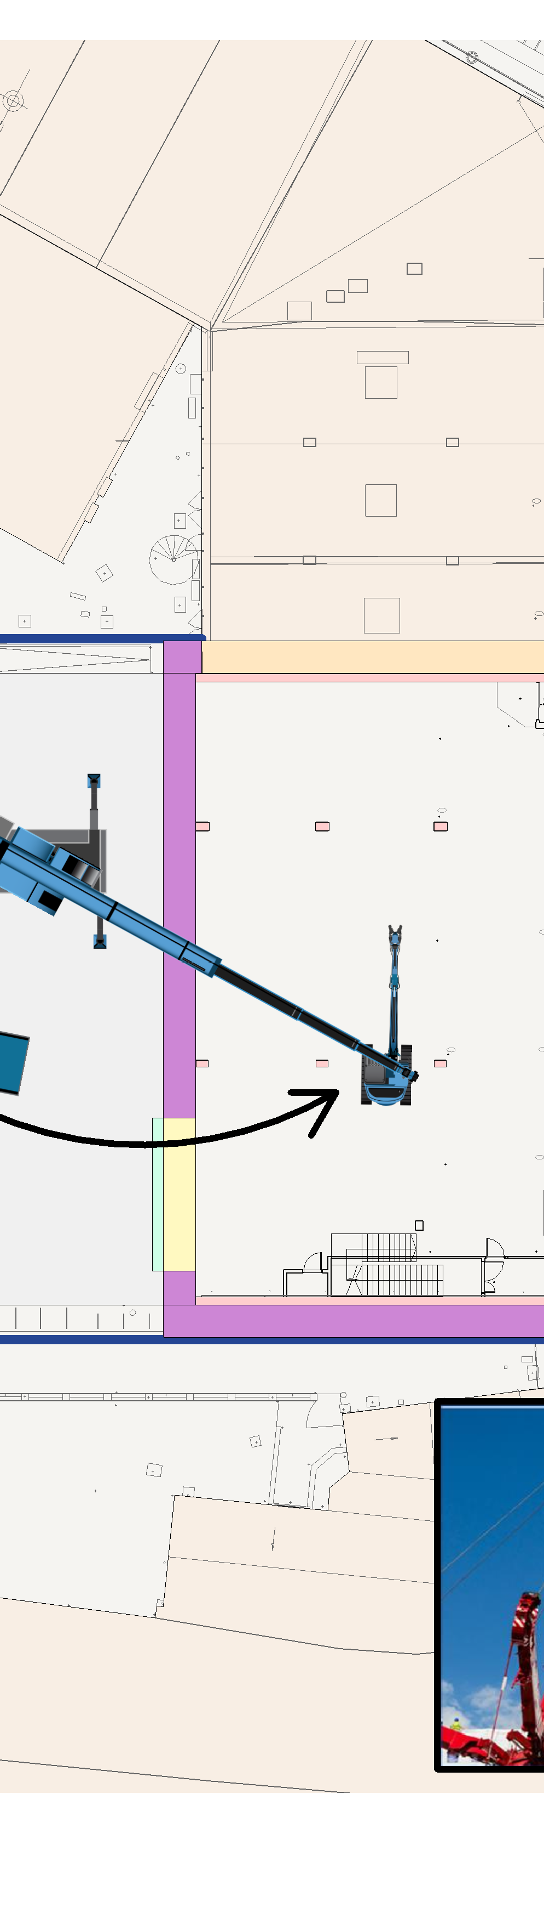
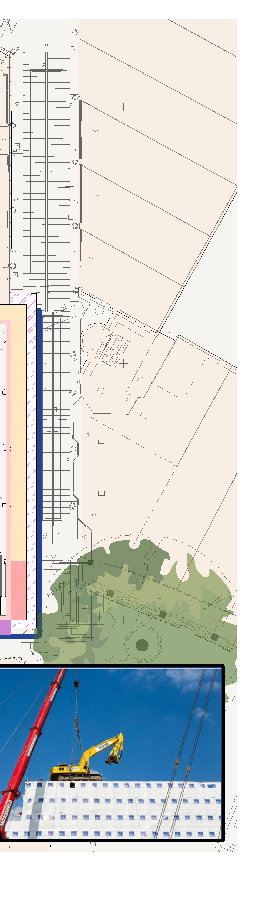
1
2
3
4
5
6
7
8
9
10
11
12
Copyright © 2021
KEY LEGEND
DENOTES TRAFFIC MARSHAL
A
ERITH HOARDING LINE
SITE GATE
DENOTES NOISE, DUST & VIBRATION MONITORING
ACCESS
A
EGRESS
SERVICE YARD
B
SUB STATION
B
HOARDING
TEMPORARY RAMP
C
C
D
D
E
37
E
MOBILE CRANE TO LIFT PLANT TO UPPER FLOOR
40 to 43
F
SITE WELFARE
F
CAR PARK
35
G
G
WAVERLEY BUILDINGS
WATERLOO COURT
WATERLOO CHANTRY
SANTANDER
H
Erith Contractors Queen Street Erith
Kent DA8 1RP
Tel: +44 (0)370 950 8800
Fax: +44 (0)370 950 8808
PROJECT:
CHANTRY CENTRE UNIT 62
3 4
DRAWING:
MOBILE CRANE VISIT
6 7
NOTES
As indicated @A1
DRAWN:
EP
CHECKED:
AH
APPROVED:
GS
H
TENDER
Scale:
1. THIS DRAWING IS TO BE READ IN CONJUNCTION
N
WITH ALL RELEVANT ARCHITECTS & ENGINEERS DRAWINGS AND SPECIFICATIONS
2. DO NOT SCALE FROM THIS DRAWING
PROJECT NO. SHEET NO.
T25-0257 - PL009
REV:
P0
1
2
5
8
9
10
11
12

Slide 11
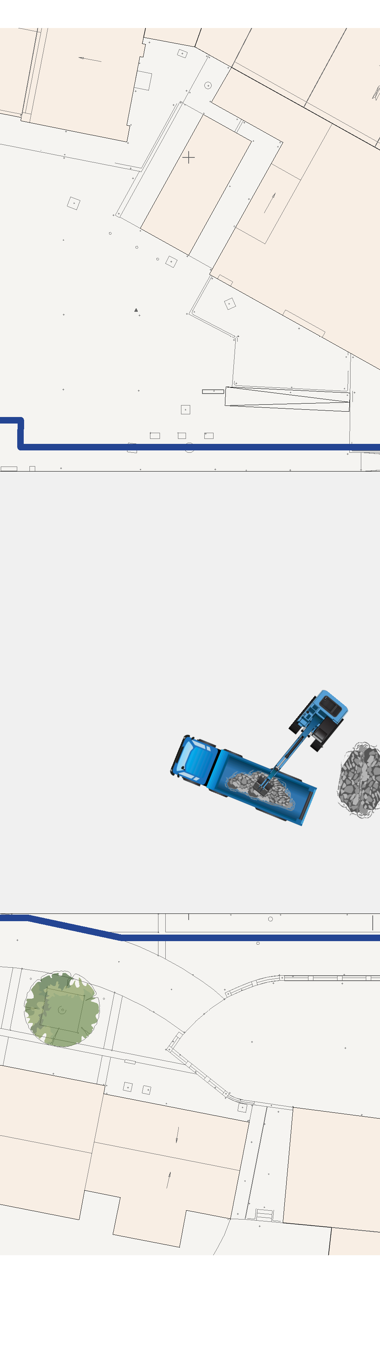
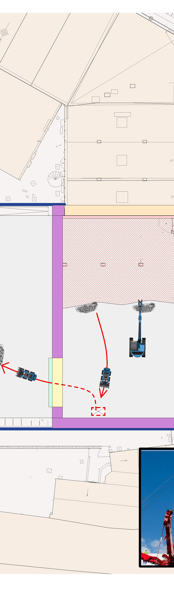
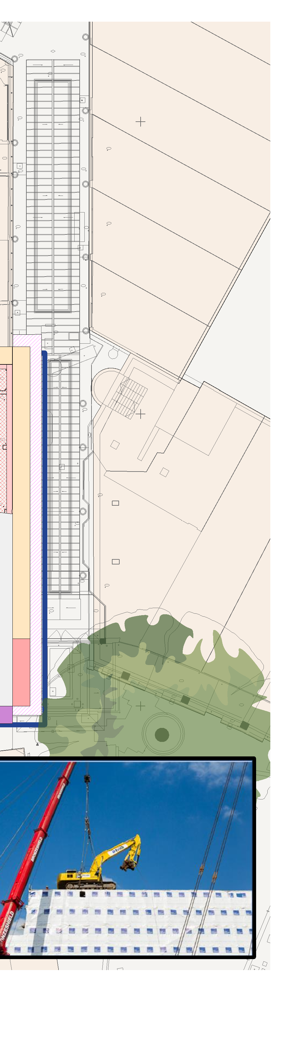
1
2
3
4
5
6
7
8
9
10
11
12
Copyright © 2021
KEY LEGEND
DENOTES TRAFFIC MARSHAL
A
ERITH HOARDING LINE
SITE GATE
DENOTES NOISE, DUST & VIBRATION MONITORING
ACCESS
A
EGRESS
SERVICE YARD
B
SUB STATION
B
HOARDING
TEMPORARY RAMP
C
C
D
D
E
37
E
40 to 43
F
SITE WELFARE
F
CAR PARK
35
G
G
WAVERLEY BUILDINGS
WATERLOO COURT
WATERLOO CHANTRY
SANTANDER
H
Erith Contractors Queen Street Erith
Kent DA8 1RP
Tel: +44 (0)370 950 8800
Fax: +44 (0)370 950 8808
PROJECT:
CHANTRY CENTRE UNIT 62
3 4
DRAWING:
PHASE 02 DEMOLITION WORK
6 7
NOTES
As indicated @A1
DRAWN:
EP
CHECKED:
AH
APPROVED:
GS
H
TENDER
Scale:
1. THIS DRAWING IS TO BE READ IN CONJUNCTION
N
WITH ALL RELEVANT ARCHITECTS & ENGINEERS DRAWINGS AND SPECIFICATIONS
2. DO NOT SCALE FROM THIS DRAWING
PROJECT NO. SHEET NO.
T25-0257 - PL010
REV:
P0
1
2
5
8
9
10
11
12

Slide 12

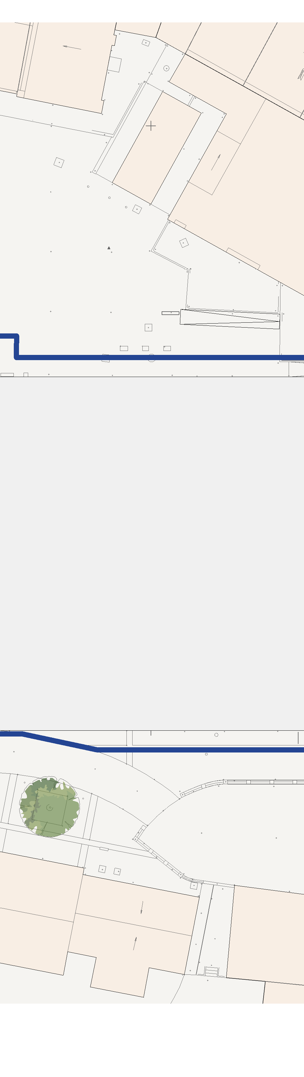
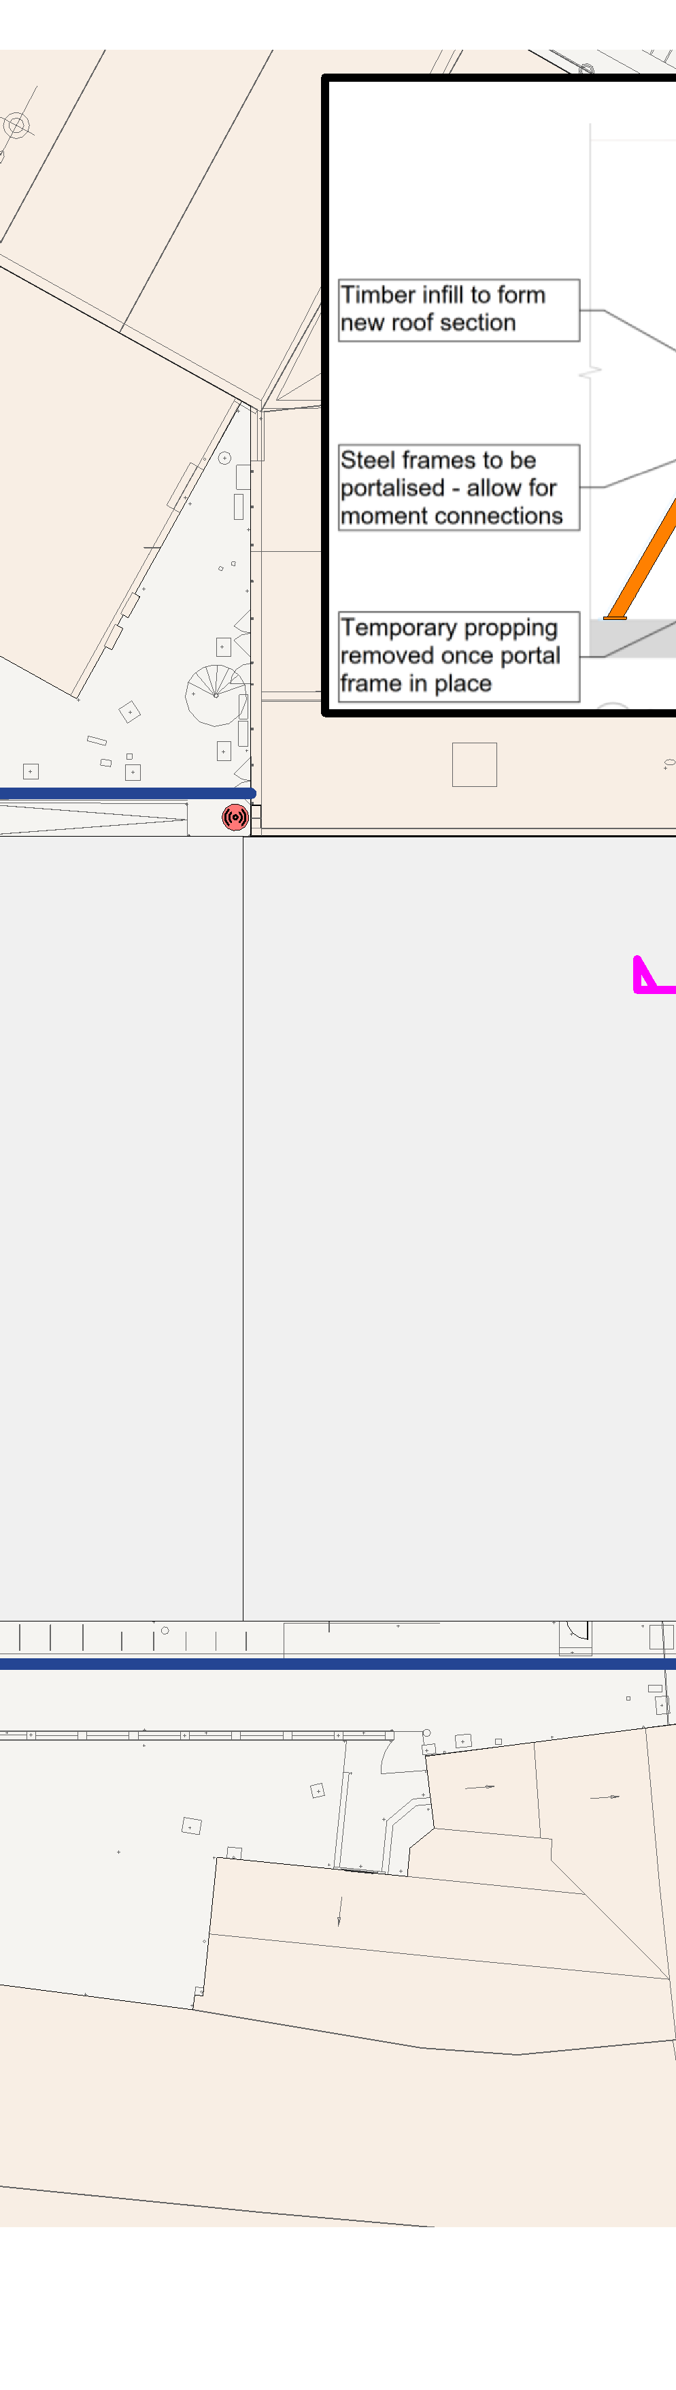
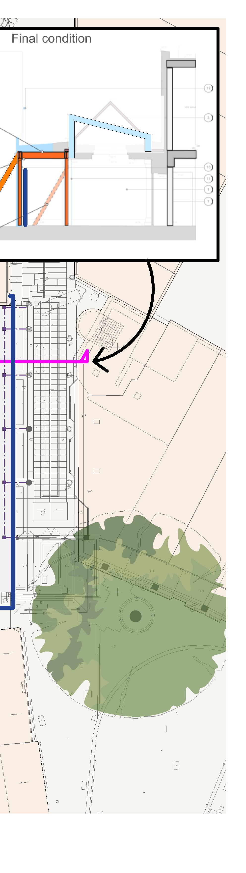
1
2
3
4
5
6
7
8
9
10
11
12
Copyright © 2021
KEY LEGEND
DENOTES TRAFFIC MARSHAL
A
ERITH HOARDING LINE
SITE GATE
DENOTES NOISE, DUST & VIBRATION MONITORING
ACCESS
REPLACE GLAZING AND SUBSTITUTE WITH TOUGHENED PLASTIC
A
ROOF DRAINAGE RECONFIGURED
EGRESS
SERVICE YARD
B
SUB STATION
B
INSTALL GRP TO
REPLICATE FORMER
HOARDING
TEMPORARY RAMP
COLUMN AESTHETIC
C
C
D
D
NEW STEELWORK
INSTALLED
HOARDING
E
RELOCATED
E
37
40 to 43
F
SITE WELFARE
F
CAR PARK
35
G
G
WAVERLEY BUILDINGS
WATERLOO COURT
WATERLOO CHANTRY
SANTANDER
H
Erith Contractors Queen Street Erith
Kent DA8 1RP
Tel: +44 (0)370 950 8800
Fax: +44 (0)370 950 8808
PROJECT:
CHANTRY CENTRE UNIT 62
3 4
DRAWING:
PROPOSED STEEL INSTALLATION
6 7
NOTES
As indicated @A1
DRAWN:
EP
CHECKED:
AH
APPROVED:
GS
H
TENDER
Scale:
1. THIS DRAWING IS TO BE READ IN CONJUNCTION
N
WITH ALL RELEVANT ARCHITECTS & ENGINEERS DRAWINGS AND SPECIFICATIONS
2. DO NOT SCALE FROM THIS DRAWING
PROJECT NO. SHEET NO.
T25-0257 - PL011
REV:
P0
1
2
5
8
9
10
11
12

Slide 13
Link for demolition video:
New Lights Theatre demolition progress - YouTube

